Slide 1
COMP6049 – Algorithm Design and Analysis
Topic 5 – Analysis of Data Structures: Stack, Queue, Tree, and Binary Tree

Slide 2
Outline Materials
Concept of ADT (abstract data type)
Stack data structure
Queue data structure
Definition of tree
Tree traversal
Binary tree characteristics
Operations in tree

Slide 3
ABSTRACT DATA TYPE
Abstract Data Type (ADT)
ADT is an abstract concept created by humans to simplify the calculation of a process through abstraction.
ADT is not directly recognized by the computer's processor, but a high level programming language can be used to implement ADT
Example of ADT
Stack
Queue
Tree
Graph

Slide 4
STACK
ADT Stack is describing a stack of data.
Rule of stack is LIFO (Last In First Out)
Implementations of stack can use array or linked-list.

Slide 5
OPERATION OF STACK
A stack in computer programming has three operations:
PUSH X (adding the data X into a stack)
POP (take the top element of a stack)
EMTPY (emptying the stack)

Slide 6
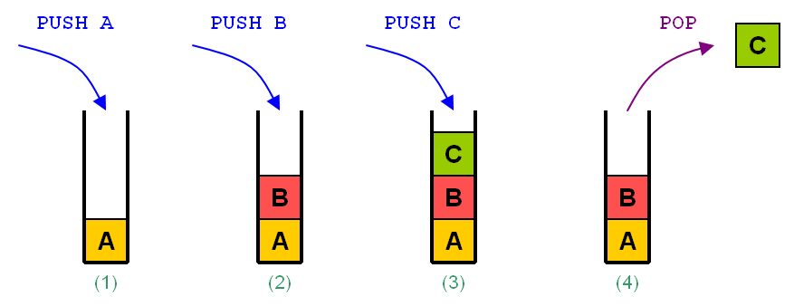
ILLUSTRATION OF STACK

Slide 7
QUEUE
Queue is an ADT that describes the data queue.
Rule of queue is FIFO (Last In First Out)
Implementations of queue can use array or linked-list

Slide 8
OPERATION OF QUEUE
A queue in computer programming has three operations:
PUSH X (adding the data X into a queue)
POP (take the top element of a queue)
EMTPY (emptying the queue)

Slide 9
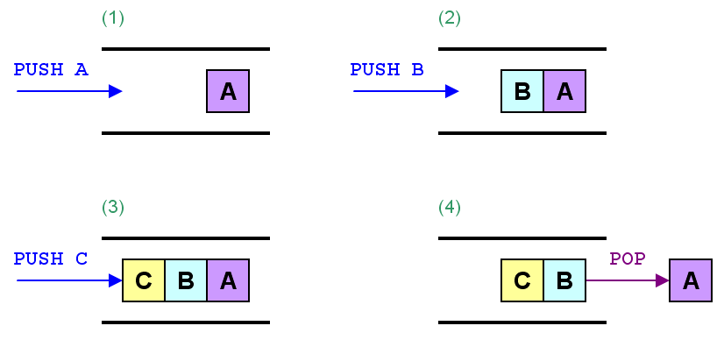
ILLUSTRATION OF QUEUE

Slide 10
CIRCULAR ADT

Slide 11
COMPARISON
When do we use stack?
When do we use queue?
What are advantage and disadvantage of stack?
What are advantage and disadvantage of queue?
Can do we combine stack and queue to solve a problem?

Slide 12
TREE
A tree is a widely-used data structure that emulates a hierarchical tree structure with a set of linked nodes.
There are a number of nodes connected on a hierarchical arrangement of the parent (parents) and child (children).
A child node must have one parent node.
A parent node can have multiple other nodes underneath it (child nodes).

Slide 13
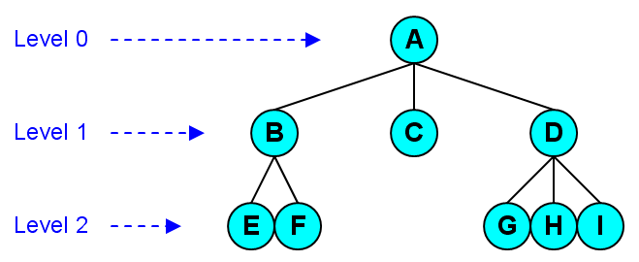
TREE ILLUSTRATIONS

Slide 14
BINARY TREE (1)
A binary tree is a tree data structure in which each node has at most two child nodes, usually distinguished as "left" and "right".
The maximum number of nodes in level k = 2^{k-1}
The maximum number of nodes in a Binary Tree depth k = 2^{k}-1

Slide 15
BINARY TREE (2)
Binary tree can be implemented in array or linked-list.
Operation in binary tree :
Inserting data
Searching data
Deleting data
Sorting data

Slide 16
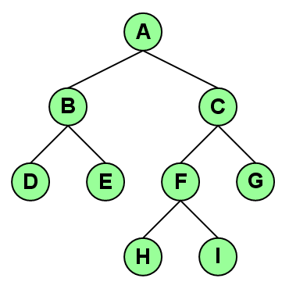
BINARY TREE ILLUSTRATIONS

Slide 17
TREE TRAVERSAL
Tree-traversal is the process of visiting (examining and/or updating) each node in a tree data structure, exactly once, in a systematic way.
Such traversals are classified by the order in which the nodes are visited.
Pre-order Traversal
parent–left–right
Level-order Traversal
parent–left–right (each level)
In-order Traversal
left–parent–right
Post-order Traversal
left–right–parent

Slide 18
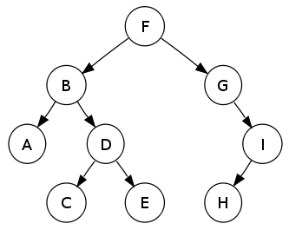
BINARY TREE TRAVERSAL
Pre-order : F, B, A, D, C, E, G, I, H
In-order : A, B, C, D, E, F, G, H, I
Post-order : A, C, E, D, B, H, I, G, F
Level-order : F, B, G, A, D, I, C, E, H

Slide 19
EULER TOUR TRAVERSAL
+
1
16
10
11
x
x
2
12
9
15
4
3
13
14
2
–
3
b
5
8
Arithmetic Expression Tree
2 x (a – 1) + (3 x b)
7
6
a
1

Slide 20
EXERCISE
Create algorithms for operation of push and pop in stack, and explain its complexity.
Create algorithms for operation of push and pop in circular queue, and explain its complexity.

Slide 21
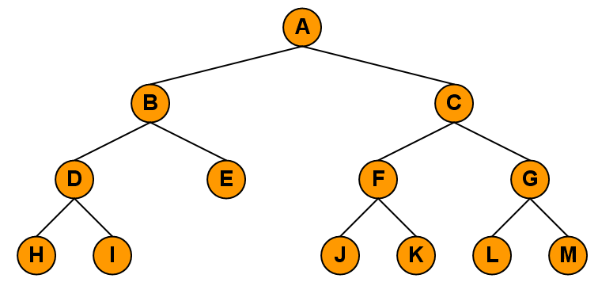
EXERCISE
Describe the differences in Tree implementations using arrays and pointers!
Do pre-order, in-order, post-order, level-order traversal for the tree below. Please do the implementation of those traversals without recursion.

Slide 22
REVIEW
Stack definition
Stack operation
Stack implementation
Queue definition
Queue operation
Queue implementation
Circular Queue
Tree
Binary tree
Binary tree traversal

Slide 23
REVIEW
Tree
Binary tree
Binary tree traversal

Slide 24
Q & A

Slide 25
References
S. Sridhar. 2014. Design and Analysis of Algorithms, 1/e. Oxford University Press. India. Chapter 5
Ellis Horowitz,Sanguthevar Rajasekaran,Sartaj Sahni. 1998. Computer algorithms/C++. 1STBL. New York. Chapter 2.1
Stack & Queue https://www.cs.cmu.edu/~adamchik/15-121/lectures/Stacks%20and%20Queues/Stacks%20and%20Queues.html

Slide 26
References
S. Sridhar. 2014. Design and Analysis of Algorithms, 1/e. Oxford University Press. India. Chapter 5
Ellis Horowitz,Sanguthevar Rajasekaran,Sartaj Sahni. 1998. Computer algorithms/C++. 1STBL. New York. Chapter 2.2
Binary Tree https://www.cs.cmu.edu/~adamchik/15-121/lectures/Trees/trees.html

Slide 27
THANK YOU

